Slide 1


Department of
Computer Science and Engineering
School of Computing
1151CS117- JAVA PROGRAMMING
UNIT II
By
S.UMA
Assistant prof/CSE

Slide 2

UNIT II - PACKAGE, INHERITANCE AND EXCEPTION HANDLING
Package Access - Java API Packages -Basics of Inheritance - Forms of Inheritance - Sub Classes and Subclass Types -Super keyword – Final - Method Overriding - Abstract Classes - Interfaces.
Exception Handling: Java Exception Hierarchy - Exception Types - Throwing and Catching exceptions -Declaring New Exception Types

Slide 3
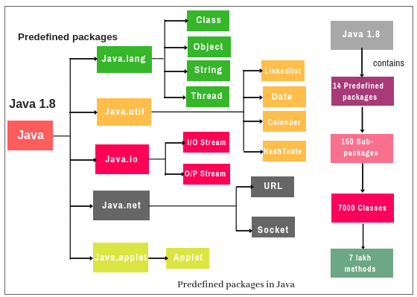
Java API Packages
A java package is a group of similar types of classes, interfaces and sub-packages.

Slide 4
Types of Package
PACKAGES
User Defined Packages
In Built Packages

Slide 5
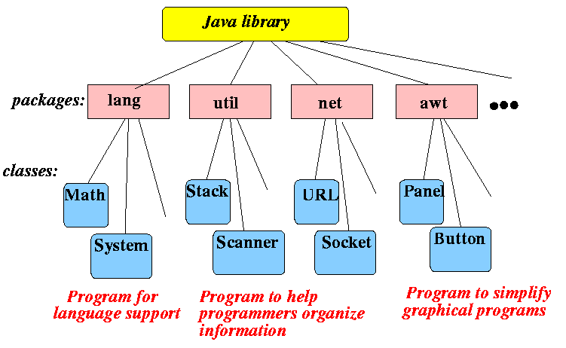
Packages and uses

Slide 6
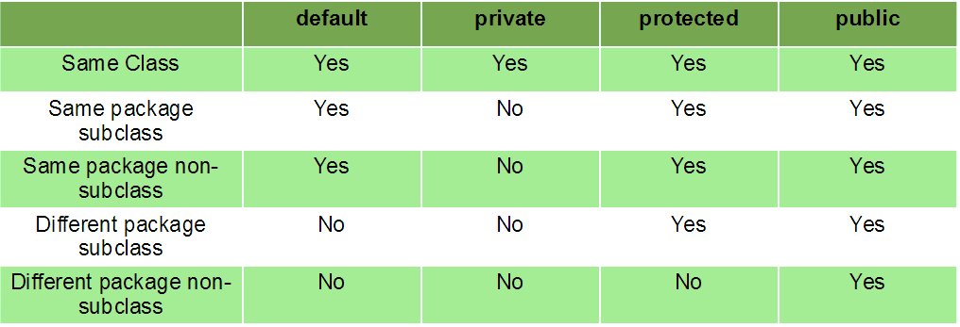
Package Access

Slide 7
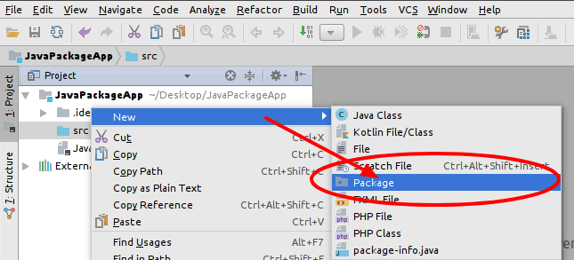
Creating a Package

Slide 8
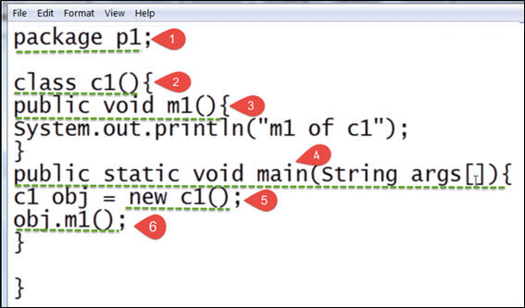
How to Create a package?
Choose the name of the package : P1
Include the package command as the first line of code in your Java Source File : package p1
The Source file contains the classes, interfaces, etc you want to include in the package
Compile to create the Java packages: javac –d . demo.java

Slide 9

Activity 1
Activity

Slide 10
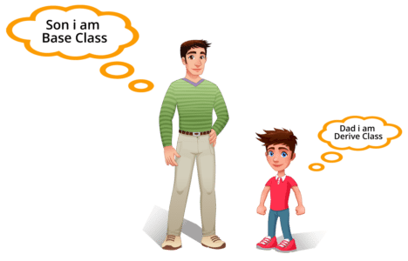
Basics of Inheritance
Inheritance in java is a mechanism in which one object acquires all the properties and behaviors of parent object
Inheritance represents the IS-A relationship, also known as parent-child relationship

Slide 11
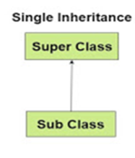
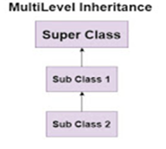
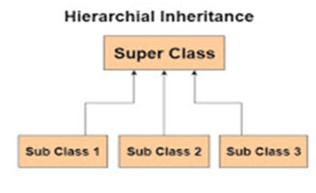
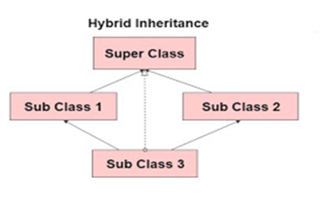
Forms of Inheritance

Slide 12
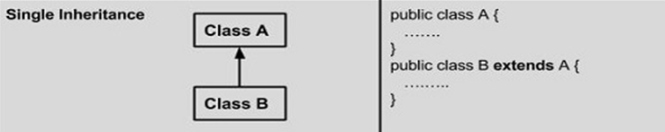
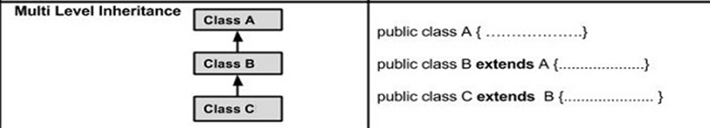
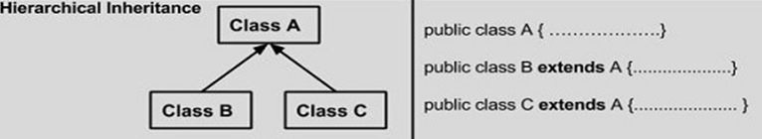
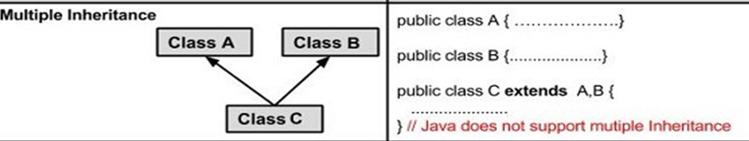
Forms of Inheritance

Slide 13
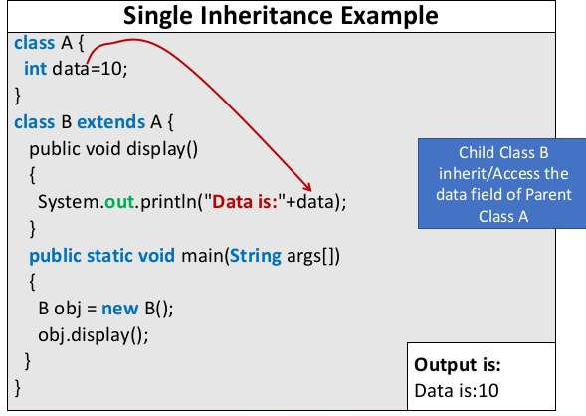
Single Inheritance

Slide 14
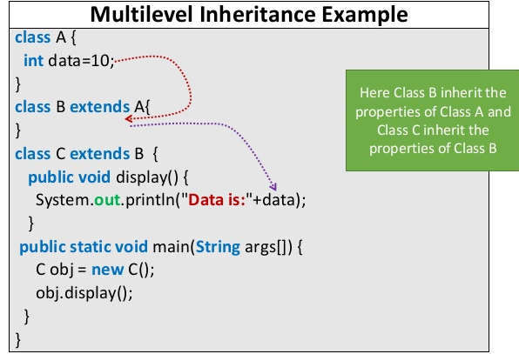
Multilevel Inheritance

Slide 15

https://edabit.com/challenge/FSKb2sKrGoejfJLrd
https://edabit.com/challenge/RNMKdSEhxdxf2fWsa
https://edabit.com/challenge/SquoES5RxWr4CyX6G
https://edabit.com/challenge/JAtN6KLtahAkmT3n3
https://edabit.com/challenge/XjYMguBCEf7WqEu8M

Slide 16
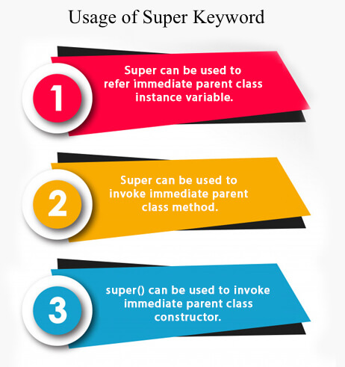
Super keyword

Slide 17
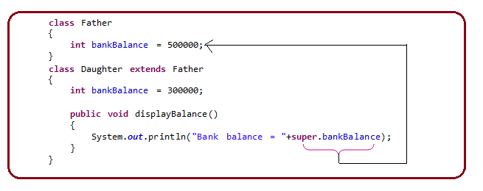
Example - super keyword

Slide 18
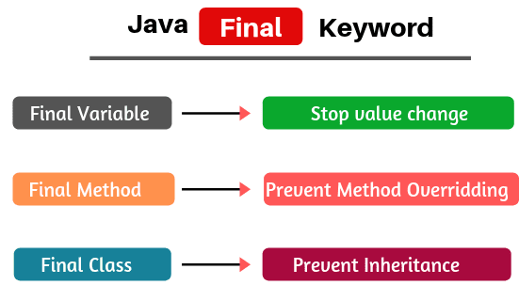
Final

Slide 19
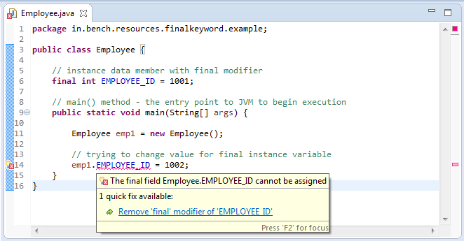
Example –Final Variable

Slide 20
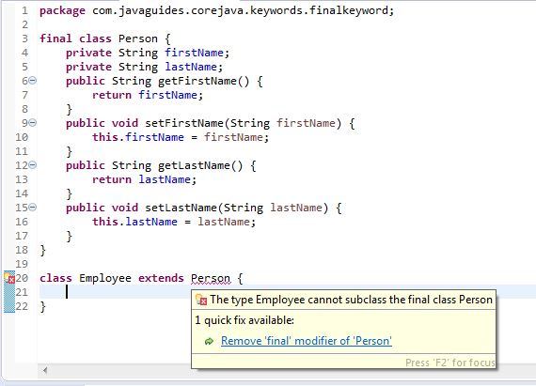
Example-Final-class

Slide 21

Building Game

Slide 22
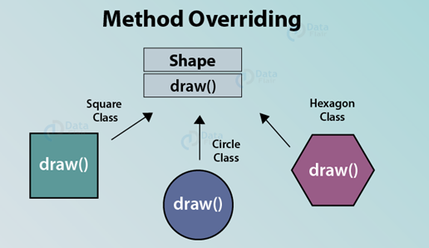
Method Overriding
If subclass (child class) has the same method as declared in the parent class, it is known as method overriding.

Slide 23
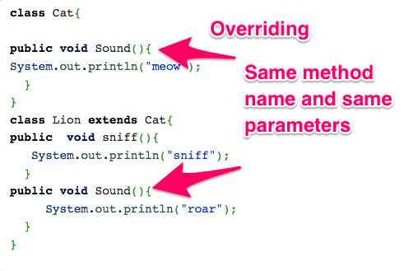
Example-overriding

Slide 24
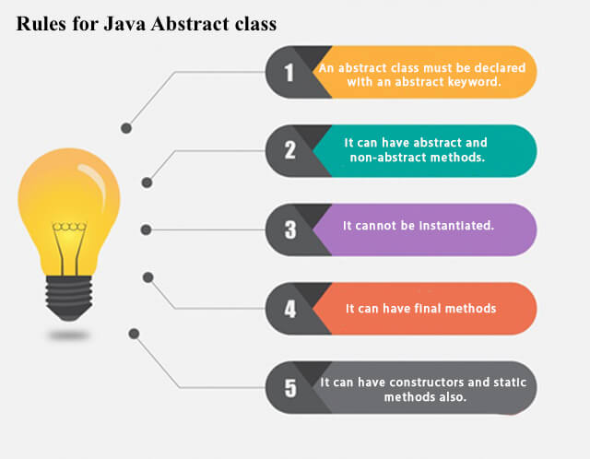
Abstract Classes
A class that is declared with abstract keyword, is known as abstract class in java. It can have abstract and non-abstract methods (method with body).

Slide 25
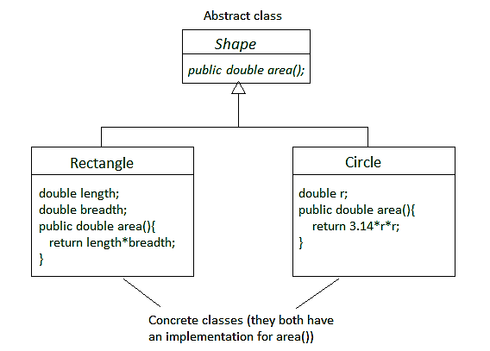
Implementation in Abstract Class

Slide 26
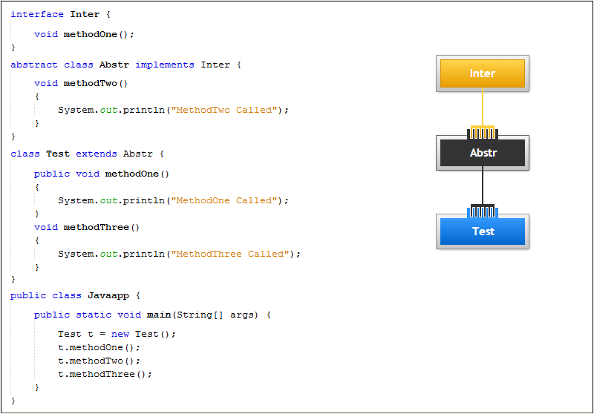
Example-Abstract class

Slide 27
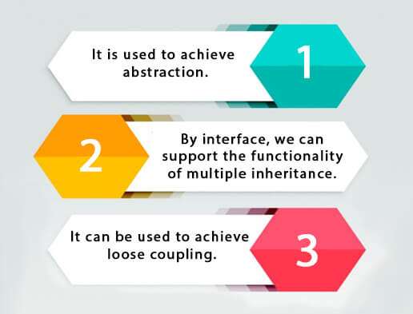
Interfaces

Slide 28
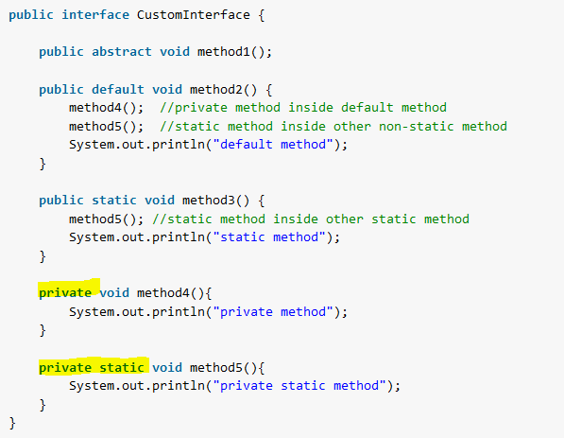
Interfaces-Example

Slide 29
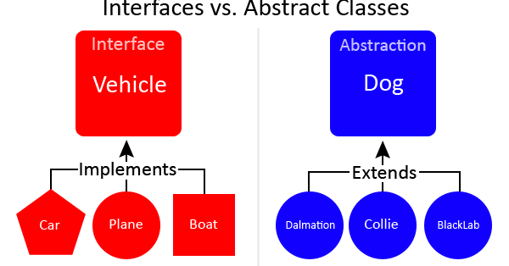
Interface Vs Abstract class

Slide 30
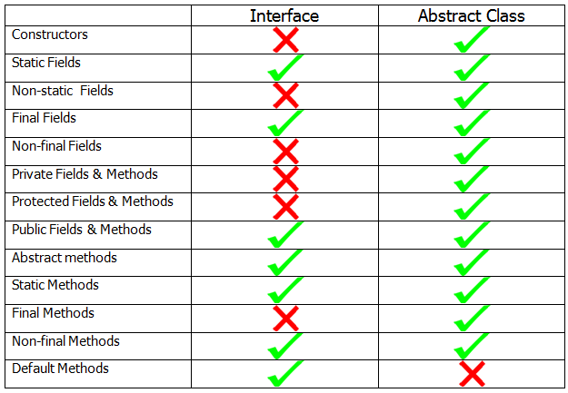
Interface Vs Abstract class

Slide 31
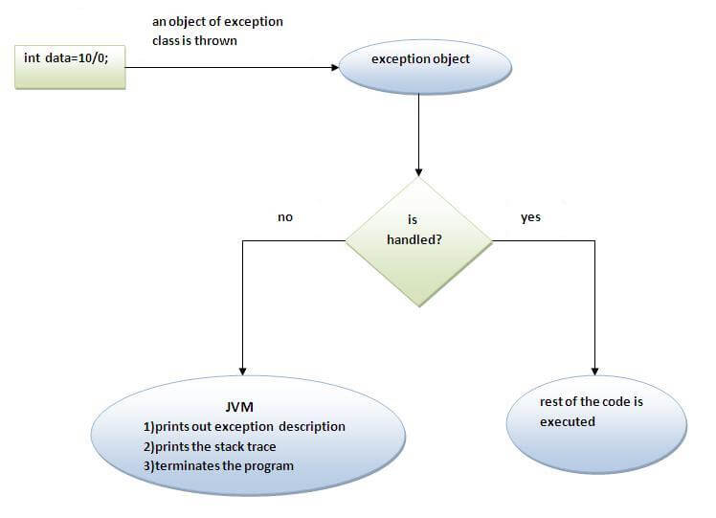
Exception Handling
The exception handling in java is one of the powerful mechanism to handle the runtime errors so that normal flow of the application can be maintained

Slide 32
Runtime Errors
Run

Slide 33
Catch Runtime Errors
Run

Slide 34
Exception Classes

Slide 35
System Errors
System errors are thrown by JVM and represented in the Error class. The Error class describes internal system errors. Such errors rarely occur. If one does, there is little you can do beyond notifying the user and trying to terminate the program gracefully.

Slide 36
Exceptions
Exception describes errors caused by your program and external circumstances. These errors can be caught and handled by your program.

Slide 37
Runtime Exceptions
RuntimeException is caused by programming errors, such as bad casting, accessing an out-of-bounds array, and numeric errors.

Slide 38
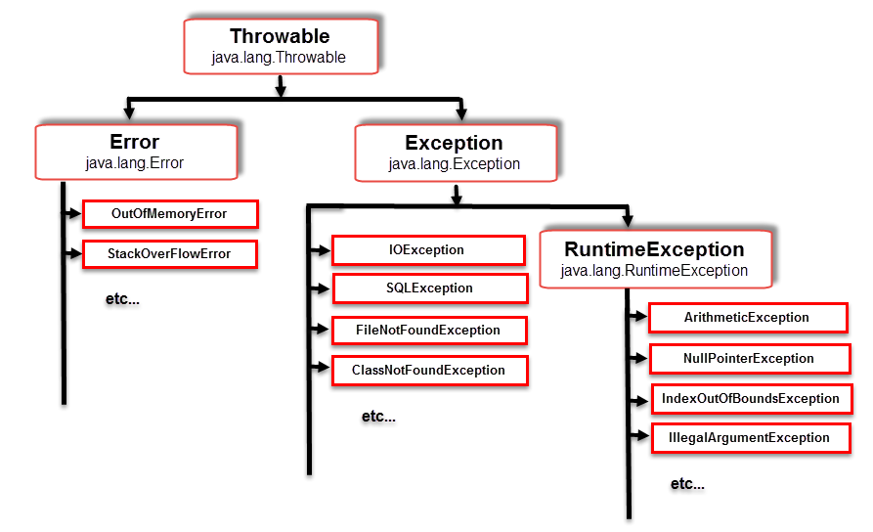
Exception-Hierarchy

Slide 39
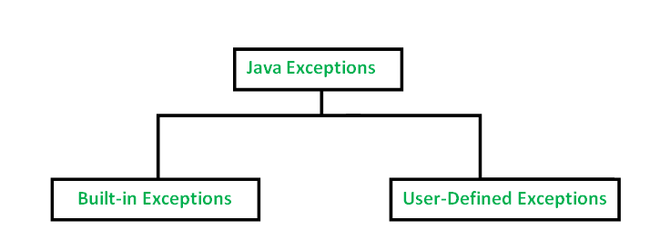
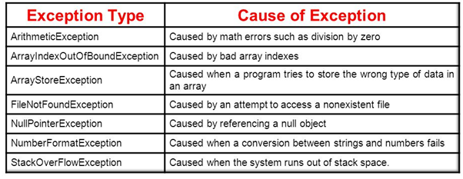
Exception Types

Slide 40
Checked Exceptions vs. Unchecked Exceptions
RuntimeException, Error and their subclasses are known as unchecked exceptions. All other exceptions are known as checked exceptions, meaning that the compiler forces the programmer to check and deal with the exceptions.

Slide 41
Checked or Unchecked Exceptions
Unchecked exception.

Slide 42
Declaring, Throwing, and Catching Exceptions

Slide 43
Declaring Exceptions
Every method must state the types of checked exceptions it might throw. This is known as declaring exceptions.
public void myMethod()
throws IOException
public void myMethod()
throws IOException, OtherException

Slide 44
Throwing Exceptions Example
/** Set a new radius */
public void setRadius(double newRadius)
throws IllegalArgumentException {
if (newRadius >= 0)
radius = newRadius;
else
throw new IllegalArgumentException(
"Radius cannot be negative");
}

Slide 45
Catching Exceptions
try {
statements; // Statements that may throw exceptions
}
catch (Exception1 exVar1) {
handler for exception1;
}
catch (Exception2 exVar2) {
handler for exception2;
}
...
catch (ExceptionN exVar3) {
handler for exceptionN;
}

Slide 46
Catching Exceptions

Slide 47
Catch or Declare Checked Exceptions
Java forces you to deal with checked exceptions. If a method declares a checked exception (i.e., an exception other than Error or RuntimeException), you must invoke it in a try-catch block or declare to throw the exception in the calling method. For example, suppose that method p1 invokes method p2 and p2 may throw a checked exception (e.g., IOException), you have to write the code as shown in (a) or (b).

Slide 48
Example: Declaring, Throwing, and Catching Exceptions
Objective: This example demonstrates declaring, throwing, and catching exceptions by modifying the setRadius method in the Circle class defined in Chapter 6. The new setRadius method throws an exception if radius is negative.
TestCircleWithException
CircleWithException
Run

Slide 49
Rethrowing Exceptions
try {
statements;
}
catch(TheException ex) {
perform operations before exits;
throw ex;
}

Slide 50
The finally Clause
try {
statements;
}
catch(TheException ex) {
handling ex;
}
finally {
finalStatements;
}

Slide 51
Trace a Program Execution
animation
Suppose no exceptions in the statements
try {
statements;
}
catch(TheException ex) {
handling ex;
}
finally {
finalStatements;
}
Next statement;

Slide 52
Trace a Program Execution
animation
The final block is always executed
try {
statements;
}
catch(TheException ex) {
handling ex;
}
finally {
finalStatements;
}
Next statement;

Slide 53
Trace a Program Execution
animation
Next statement in the method is executed
try {
statements;
}
catch(TheException ex) {
handling ex;
}
finally {
finalStatements;
}
Next statement;

Slide 54
Trace a Program Execution
animation
try {
statement1;
statement2;
statement3;
}
catch(Exception1 ex) {
handling ex;
}
finally {
finalStatements;
}
Next statement;
Suppose an exception of type Exception1 is thrown in statement2

Slide 55
Trace a Program Execution
animation
try {
statement1;
statement2;
statement3;
}
catch(Exception1 ex) {
handling ex;
}
finally {
finalStatements;
}
Next statement;
The exception is handled.

Slide 56
Trace a Program Execution
animation
try {
statement1;
statement2;
statement3;
}
catch(Exception1 ex) {
handling ex;
}
finally {
finalStatements;
}
Next statement;
The final block is always executed.

Slide 57
Trace a Program Execution
animation
try {
statement1;
statement2;
statement3;
}
catch(Exception1 ex) {
handling ex;
}
finally {
finalStatements;
}
Next statement;
The next statement in the method is now executed.

Slide 58
Trace a Program Execution
animation
try {
statement1;
statement2;
statement3;
}
catch(Exception1 ex) {
handling ex;
}
catch(Exception2 ex) {
handling ex;
throw ex;
}
finally {
finalStatements;
}
Next statement;
statement2 throws an exception of type Exception2.

Slide 59
Trace a Program Execution
animation
try {
statement1;
statement2;
statement3;
}
catch(Exception1 ex) {
handling ex;
}
catch(Exception2 ex) {
handling ex;
throw ex;
}
finally {
finalStatements;
}
Next statement;
Handling exception

Slide 60
Trace a Program Execution
animation
try {
statement1;
statement2;
statement3;
}
catch(Exception1 ex) {
handling ex;
}
catch(Exception2 ex) {
handling ex;
throw ex;
}
finally {
finalStatements;
}
Next statement;
Execute the final block

Slide 61
Trace a Program Execution
animation
try {
statement1;
statement2;
statement3;
}
catch(Exception1 ex) {
handling ex;
}
catch(Exception2 ex) {
handling ex;
throw ex;
}
finally {
finalStatements;
}
Next statement;
Rethrow the exception and control is transferred to the caller

Slide 62

Activity

Slide 63
When to Throw Exceptions
An exception occurs in a method. If you want the exception to be processed by its caller, you should create an exception object and throw it. If you can handle the exception in the method where it occurs, there is no need to throw it.

Slide 64
When to Use Exceptions
When should you use the try-catch block in the code? You should use it to deal with unexpected error conditions. Do not use it to deal with simple, expected situations. For example, the following code
try {
System.out.println(refVar.toString());
}
catch (NullPointerException ex) {
System.out.println("refVar is null");
}

Slide 65
When to Use Exceptions
is better to be replaced by
if (refVar != null)
System.out.println(refVar.toString());
else
System.out.println("refVar is null");

Slide 66
Creating Custom Exception Classes
Use the exception classes in the API whenever possible.
Create custom exception classes if the predefined classes are not sufficient.
Declare custom exception classes by extending Exception or a subclass of Exception.

Slide 67
Custom Exception Class Example
In Listing 17.1, the setRadius method throws an exception if the radius is negative. Suppose you wish to pass the radius to the handler, you have to create a custom exception class.
InvalidRadiusException
CircleWithRadiusException
TestCircleWithRadiusException
Run

Slide 68
throw and throws keyword
No. | throw | throws
1) | Java throw keyword is used to explicitly throw an exception. | Java throws keyword is used to declare an exception.
2) | Checked exception cannot be propagated using throw only. | Checked exception can be propagated with throws.
3) | Throw is followed by an instance. | Throws is followed by class.
4) | Throw is used within the method. | Throws is used with the method signature.
5) | You cannot throw multiple exceptions. | You can declare multiple exceptions e.g. public void method()throws IOException,SQLException.

Slide 69
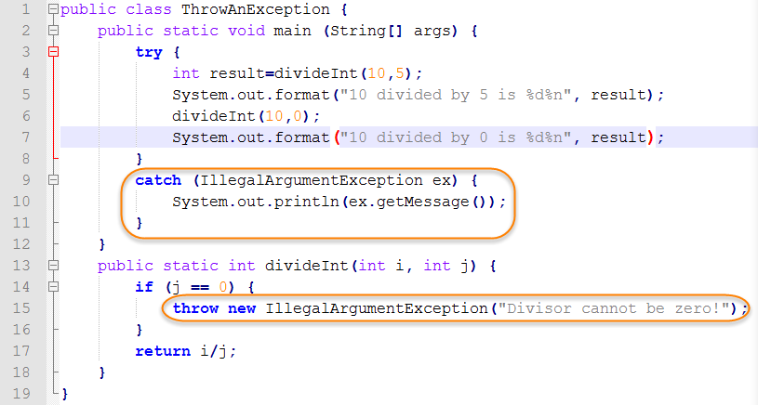
Throwing and Catching exceptions

Slide 70

Quiz

Slide 71


